Slide 1
INTERNSHIP Report
Guide – Prof. Punnet.E.Patel

Slide 2
Personal Information
Name :Sanchit Sanjay Chaudhari
Year : Third Year
Branch : Information Technology
Roll No :11
Subject : Internship
Academic Year: 2024-2025

Slide 3
Company Details
Name : Cognifyz Technology
Email :cognifyztechnologies@gmail.com
Phone Number : 7066644855
Web :www.cognifyz.com

Slide 4
Selection Process
Step 1 : Selection of CV
Step 2 : Telephonic Interview
- Scheduled on March 4,2025
- Interviewer :Sahil Lambat
Step 3 : Final Selection Mail
- Received date:March 6,2025

Slide 5
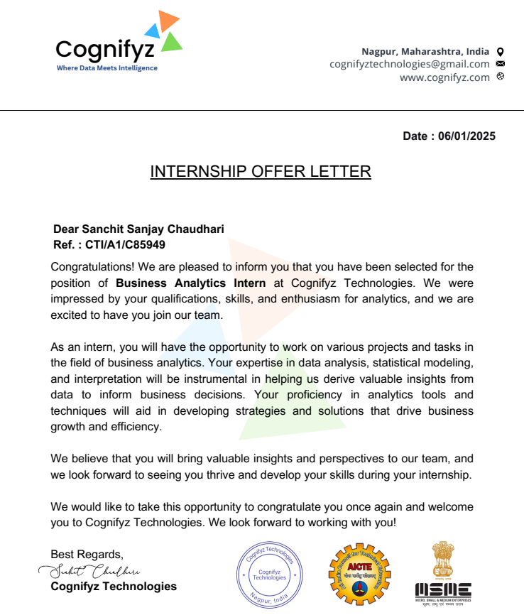
Offer Letter

Slide 6
Internship Details
Role : Business Analyst Intern
Location : Remote
Duration: 4 Weeks
Perks : Certificate, Training , Offer Letter

Slide 7
Project Manager Details
Project Manager Name:Sahil Lambat
Email :sahillambat@cognifyz.com
Phone number :7066644855

Slide 8
Official Communication Medium
Email as an Official Communication Medium Email is widely recognized as the primary medium for official communication in organizations.

Slide 9
Weekly Details (4Weeks Work Schedule )
Sr. No. | Week | Date | Task Done
1 | Week 1 | 07-01-2025 | 13-01-2025
2 | Week 2 | 14-01-2025 | 20-01-2025
3 | Week 3 | 21-01-2025 | 26-01-2025
4 | Week 4 | 27-01-2025 | 02-01-2025

Slide 10
Week 01:
• Understood business requirements and KPIs
• Collected past 3 months sales data
• Conducted meetings with stakeholders
• Identified main focus: customer segmentation & product performance
Week 01:

Slide 11
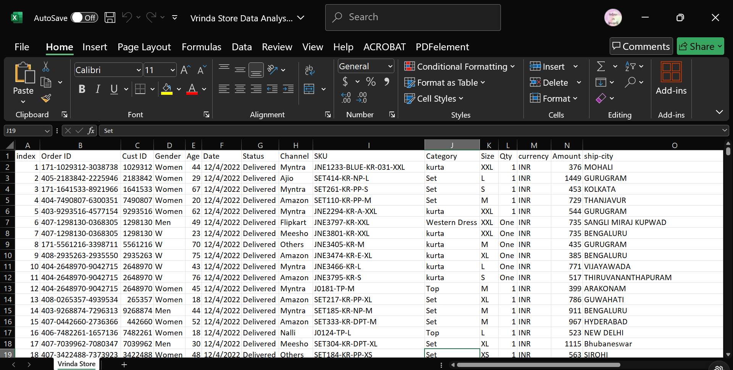

Slide 12
Questions:
1)Compare the Sales and Orders using single chart
2)Which month Got the highest Sales and Orders?
3)Who purchased more men or women ?
4)What are the different order status?
5)List top states contributing to the sales?
6)Relation between age and gender based on number of orders
7)Highest selling category?

Slide 13
Week 02:
• Cleaned and organized sales data using Excel
• Created pivot tables to identify top-selling products
• Shared findings in a team
Week 02:

Slide 14
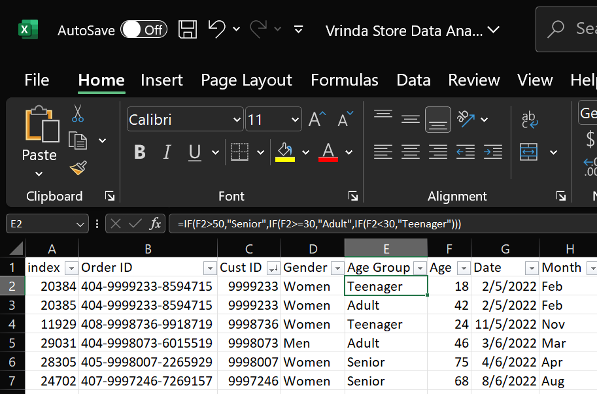

Slide 15
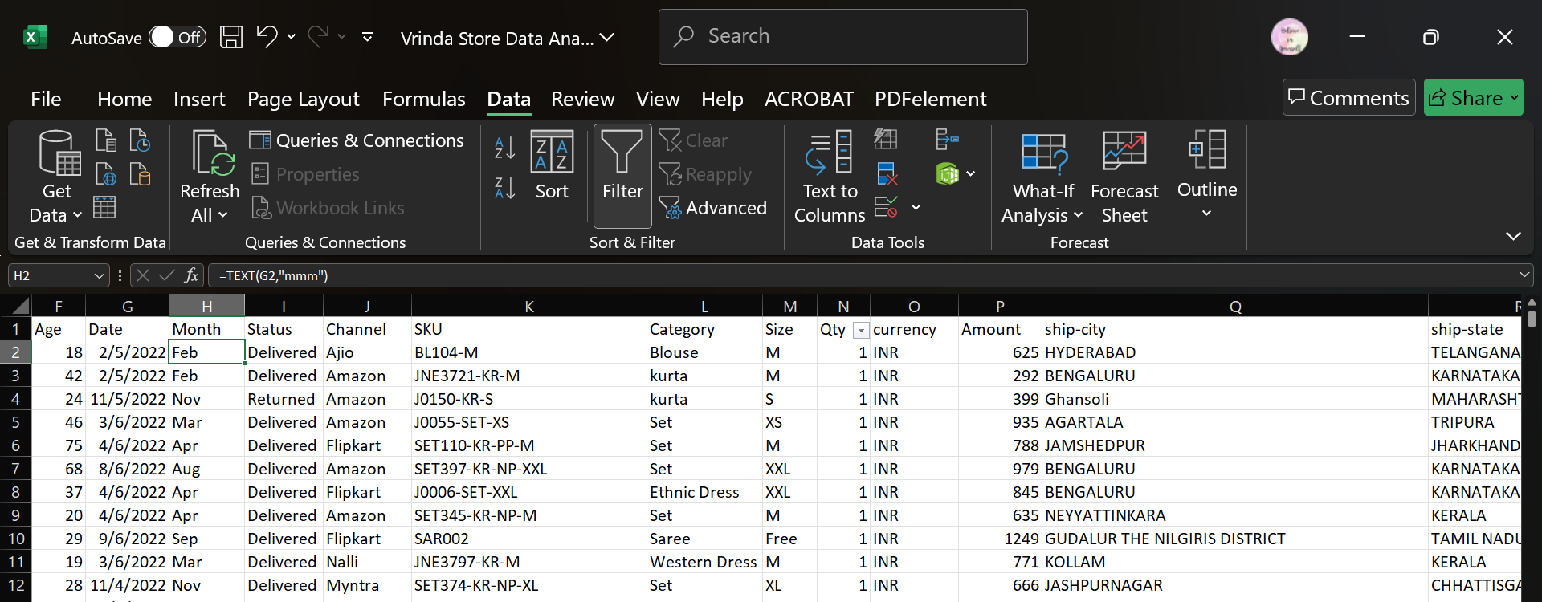

Slide 16
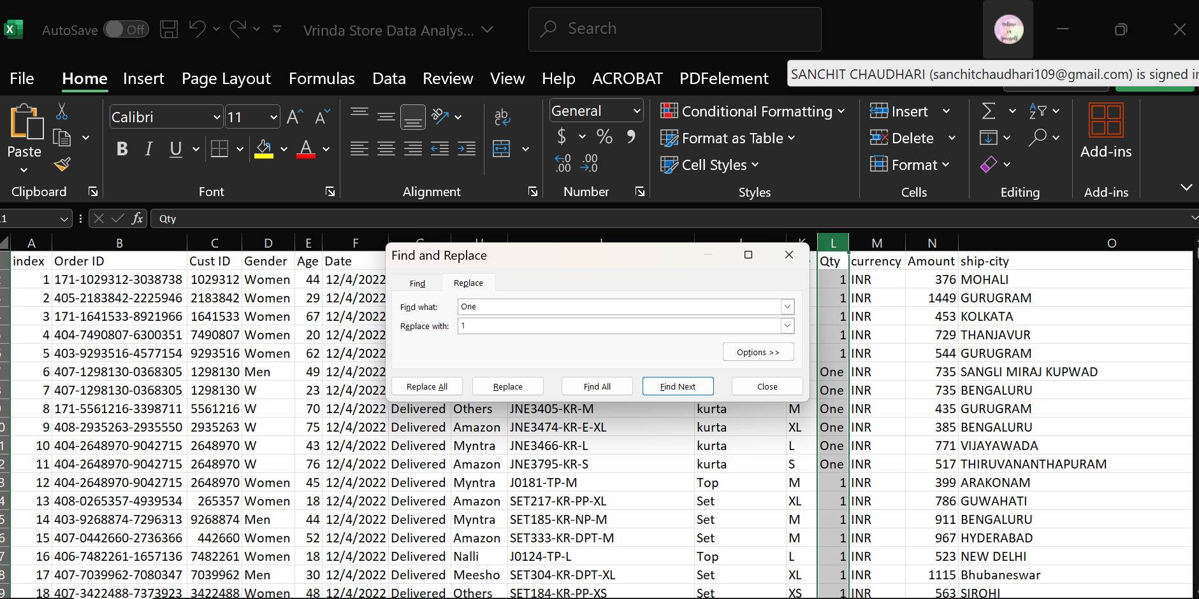

Slide 17
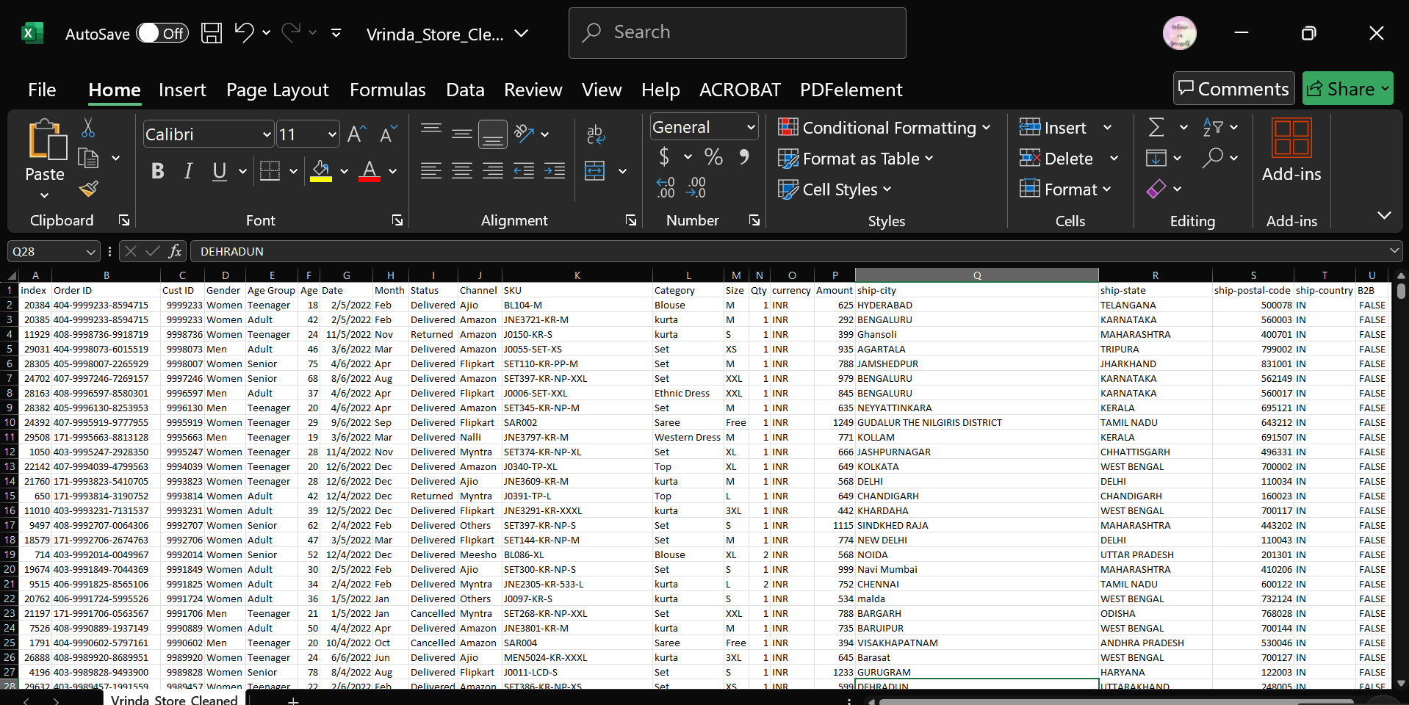

Slide 18
Top Selling Products

Slide 19
Week 03:
• Focused on customer behavior
• Built Power BI dashboards for customer segmentation
• Proposed insights on seasonal product performance • Visualized product category trends in Power BI
Week 03:

Slide 20
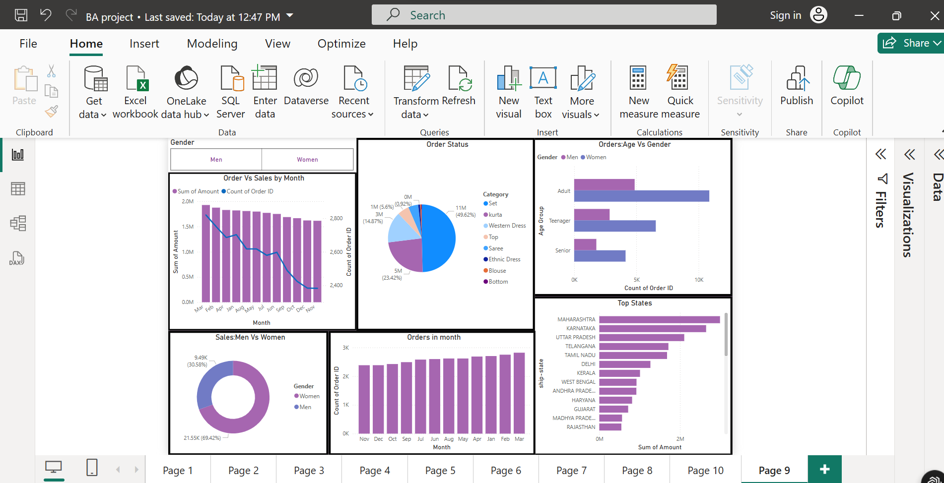

Slide 21
Week 04:
• Finalized insights and formatted executive report
• Presented dashboard to mentors
• Discussed possible actions based on the report
Week 04:

Slide 22
Key Insights:
Women (69%) drive most sales, especially adult women.
"Set" and "Saree" are the top-selling product categories.
Sales are stable, but order count is declining – fewer, higher-value orders.
Top states by sales: Maharashtra, Karnataka, and Uttar Pradesh.

Slide 23
Strategic Recommendations
1)Target female customers, especially adult women.
2)Boost stock and promotions for "Sets" and "Sarees", the top-selling categories.
3)Focus on high-performing states like Maharashtra and Karnataka for marketing and distribution.
4)Investigate the decline in order volume despite stable revenue – maybe fewer but higher-price items?
5)Analyze customer preferences by age group

Slide 24

Certificate:

Slide 25
The internship at Cognifyz Technology provided valuable hands-on experience as a Business Analyst. Throughout the four weeks, I developed essential skills in business analysis, communication, and reporting. Using tools like Excel and Power BI, I was able to transform raw data into meaningful insights. This opportunity enhanced my understanding of real-world business processes and strengthened my analytical mindset.
Conclusion:

